Slide 1
GYM MANNAGMENT SYSTEM

Slide 2
SOFTWARE REQUIREMENTS:
Front end : HTML, CSS.
Back end : FIREBASE
Control end : java script
AUTHOR: NITU KUMARI

Slide 3
AIM OF THE PROJECT
In many Gyms, the payment receipts are in paper format. So it is very difficult for both gym members to keep all the paper receipts safely and to gym trainer to keep reminding for the fee receipts.
Sometimes it creates a trouble when members lost their receipts. The other problem that can be faced by a gym owner is that if he/she wants to inform any message related to working or non-working days of gym, manually sending message become difficult. If there is online application available these problems can be solved.
So, I am developing an application to overcome some of these issues. So this project can be helpful for both gym owner as well as for gym members.
In this application all receipts are store in a digital format, so there are no issues of losing any confidential receipts. This application will also notify the user (gym members) about their fees and also notifies the gym owner about the payment clearance.
This application can be elaborated by providing supplement store, diet information, personal training etc. every member handle the diet maintenance with once registration and also provide a personal training for each and every members.

Slide 4
OBJECTIVE OF THIS PROJECT
The objective of this system is to digitalize and create an automated system. The system will perform the task like adding the new member to the gym, removing the member or keeping the payments records and other stuff required in managing the gym properly.
Automating the existing system.
Reducing time taken to enter client and staff data.
To centralize the management of the gym and fitness center.
Reduce data loss in the manual system already in place.
Reduce the cost of maintenance of the gym and data storage and reducing the space occupied the files being used.
Make data retrieval easy and reduce time wasted when manually searching for data.
Reduce data redundancy. Redundancy is the repetition of similar data in the system. Redundancy occurs when data is updated so there occurs more than one copy of data I which consumes a lot of space.

Slide 5
EXISTING SYSTEM
The gym is working manually. The current system is time consuming and also it is very costly, because it involves a lot of paperwork. To manually handle the system was very difficult task. But now-a-days computerization made easy to work. The following are the reasons why the current system should be computerized:
To increase efficiency with reduced cost.
To reduce the burden of paper work.
To save time management for recording details of each and every member and employee.
To generate required reports easily.

Slide 6
DISADVANTAGES OF EXISTING SYSTEM
1. Time consumption:
As the records are to be manually maintained it consumes a lot of time.
2. Paper work:
Lot of paper work is involved as the records are maintained in the files & registers
3. Storage requirements:
As files and registers are used the storage space requirement is increased.
4. Less reliable:
Use of papers for storing valuable data information is not at all reliable.
5. Accuracy:
As the system is in manual there are lot many chances of human errors. These can cause errors in calculating mechanism or maintaining customer details.
6. Difficulty in keeping new records:
It is difficult for keeping all the new entries of members, their account and transaction details.

Slide 7
PROPOSED SYSTEM
The proposed system is used for stores records of the system.
It is easier to find the user names, workout timings, summery etc.
Time table is orderly arranged. It has implemented an information of about the gym, about fees structure and schedule of workout days and also schedule of daily diet for every members.
Then, the gym was provided a supplement store for viewing what all specialties’ are of workout and diet. Gym admin can maintain the daily attendance and workout summery.
This application will also notify the user (gym members) about their fees and also notifies the gym owner about the payment clearance.

Slide 8
ADVANTAGES OF PROPOSED SYSTEM
The proposed system is highly secured, because for login the system it requires the username and password which is different for each department therefore providing each department a different view of the customer information.
It provides wide range of certain criteria in each window the client is working for better and quicker solution.
It maintains report for all criteria and transactions.
Manages member information separately for all bill information separately for considering the requirement of gym.
Stores information about regular products.
Diet recommendation

Slide 9
MODULE LIST
ADMINISTRATOR
Login
Add Member
Update/Delete Members
Create Bills
Assign Fee Package
Assign Notification for monthly
Report export
Supplement store
Diet Details

Slide 10
MODULE LIST
Members
Login
View Bill Receipts
View bill notification

Slide 11
MODULE LIST
User
Login
View details
Search records

Slide 12
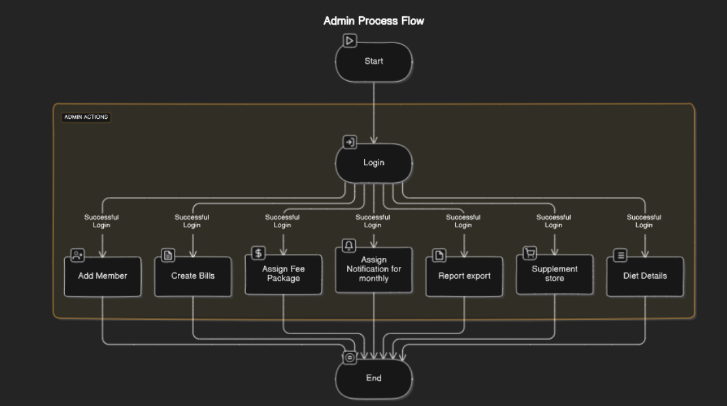
ADMIN

Slide 13
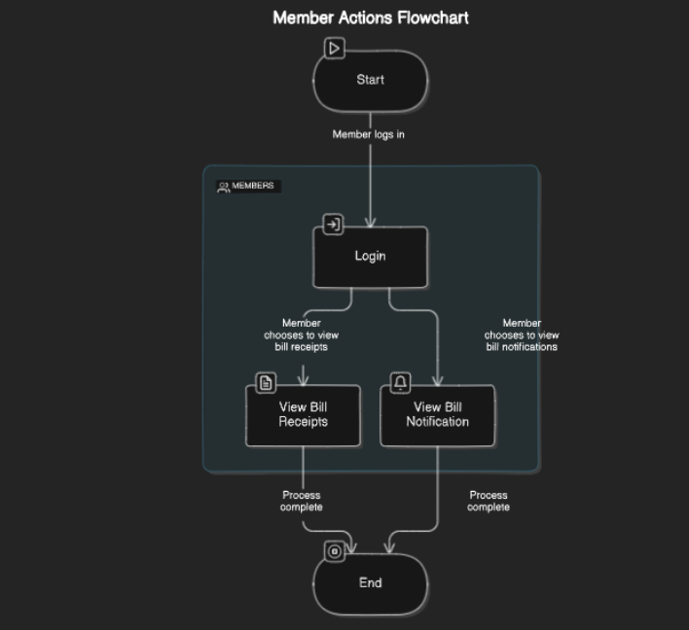
MEMBER

Slide 14
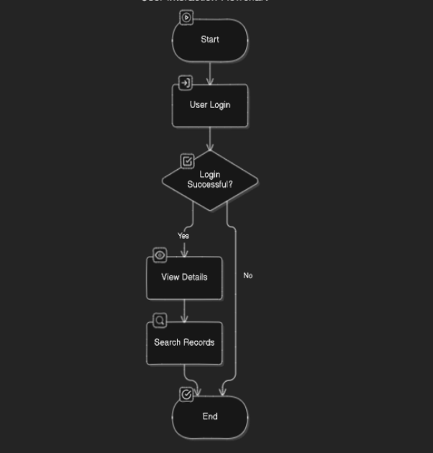
USER

Slide 15
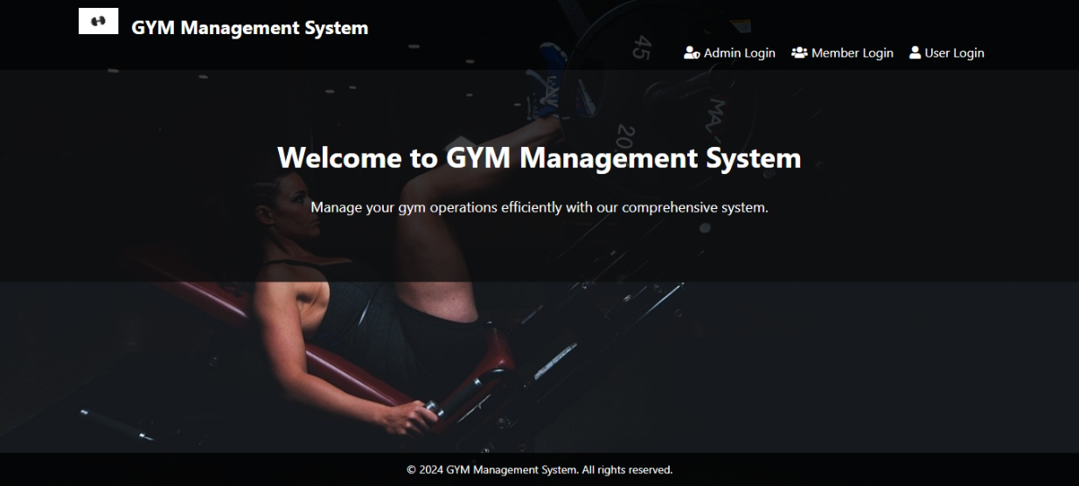
HOME PAGE

Slide 16
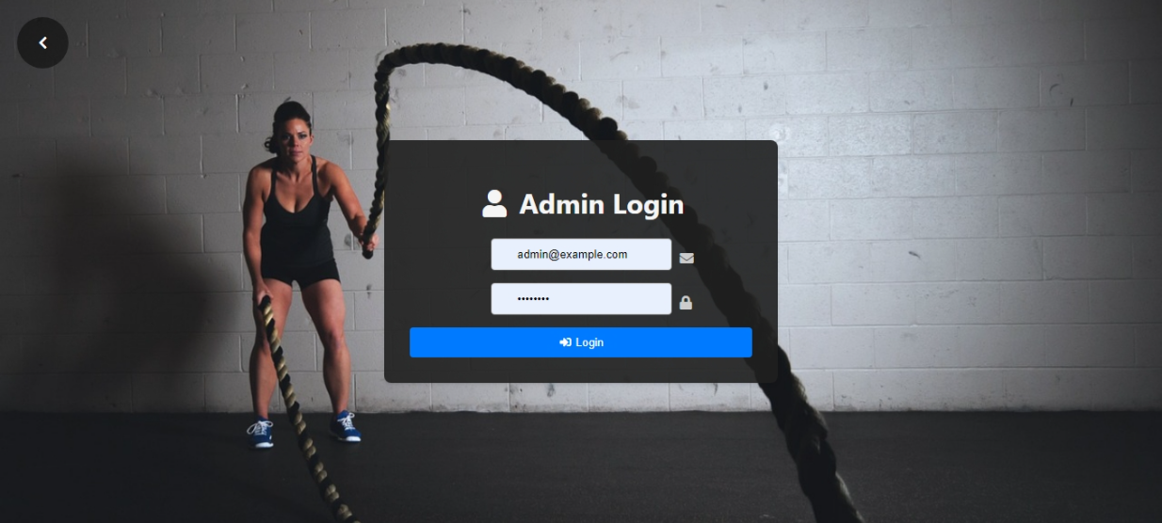
Admin login

Slide 17
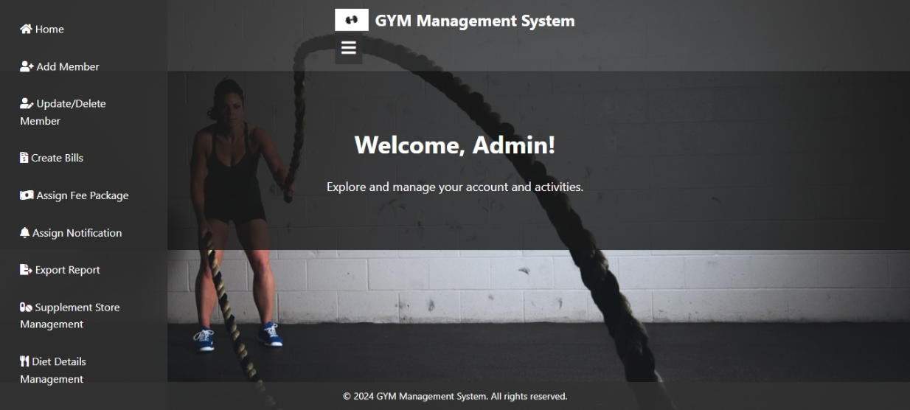
ADMIN HOME PAGE

Slide 18
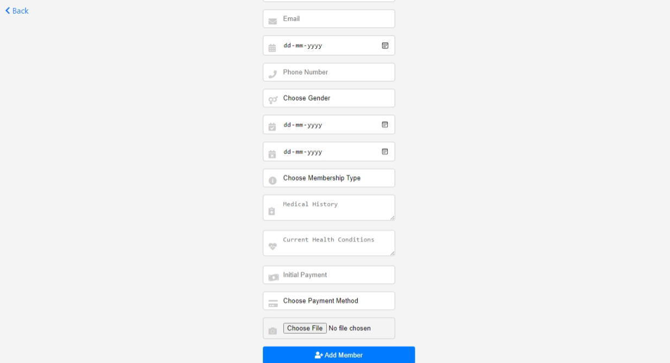
ADD MEMBER

Slide 19
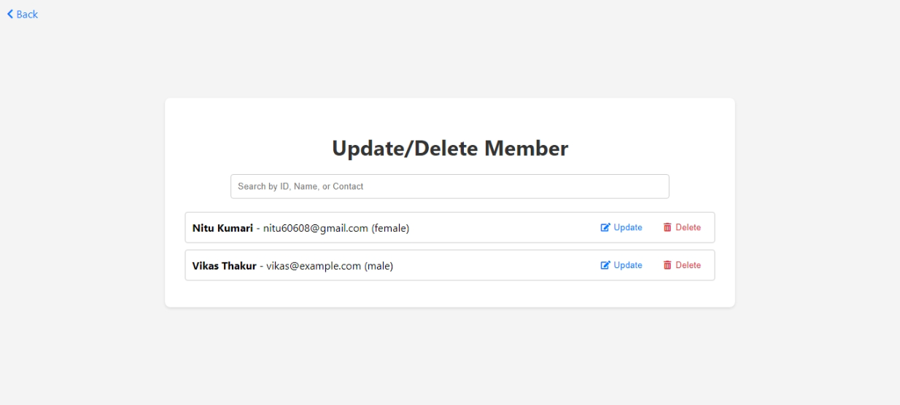
ADMIN

Slide 20
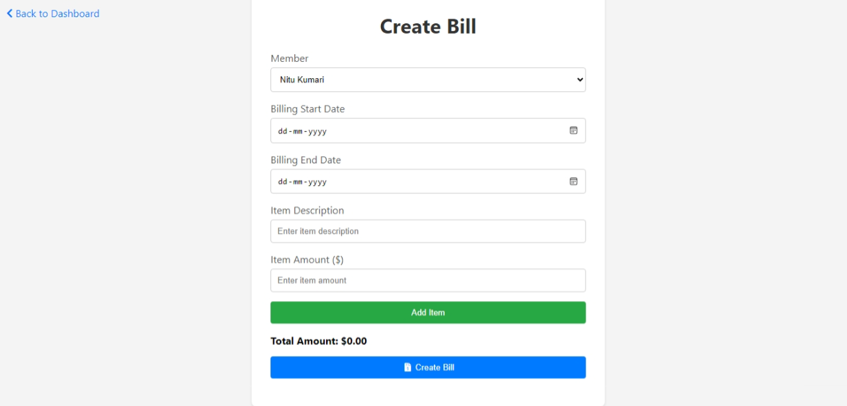
ADMIN

Slide 21
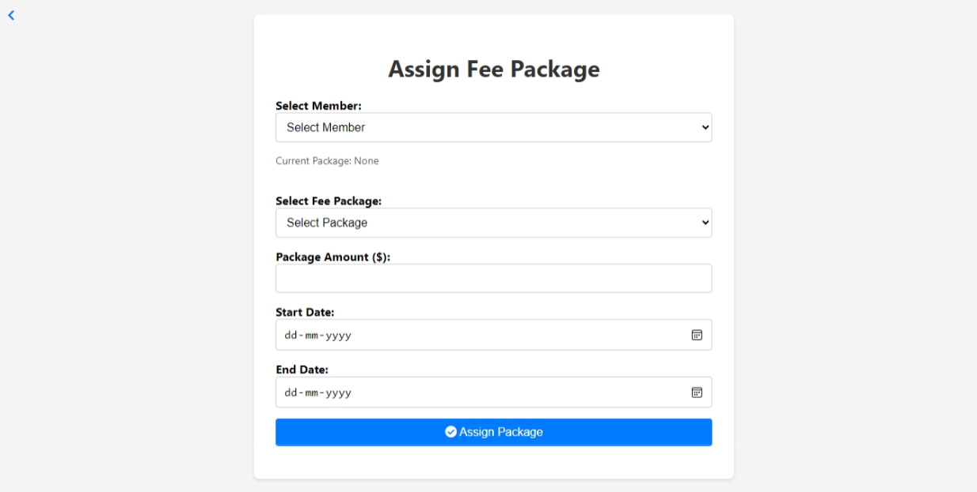
ADMIN

Slide 22
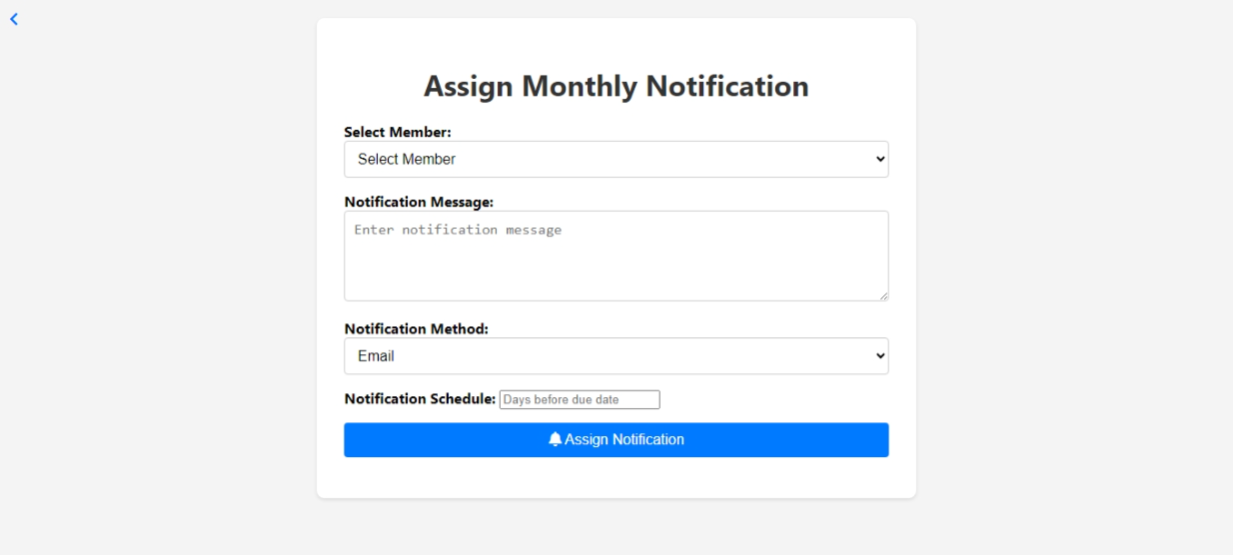
ADMIN

Slide 23
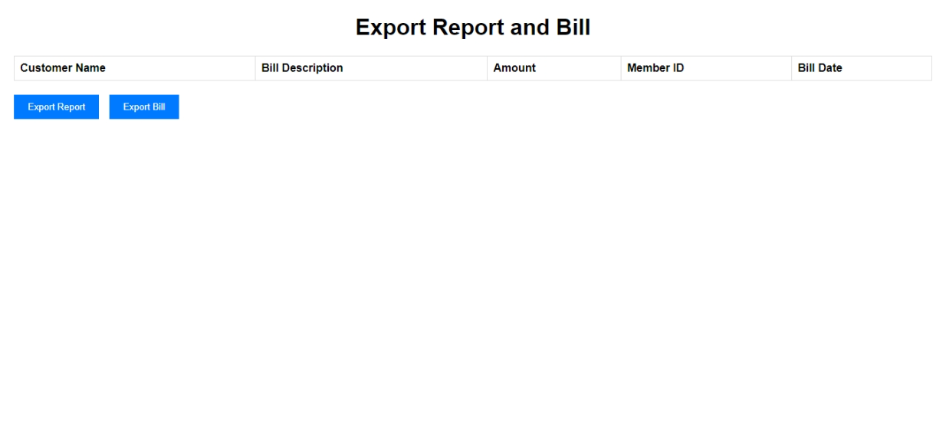
ADMIN

Slide 24
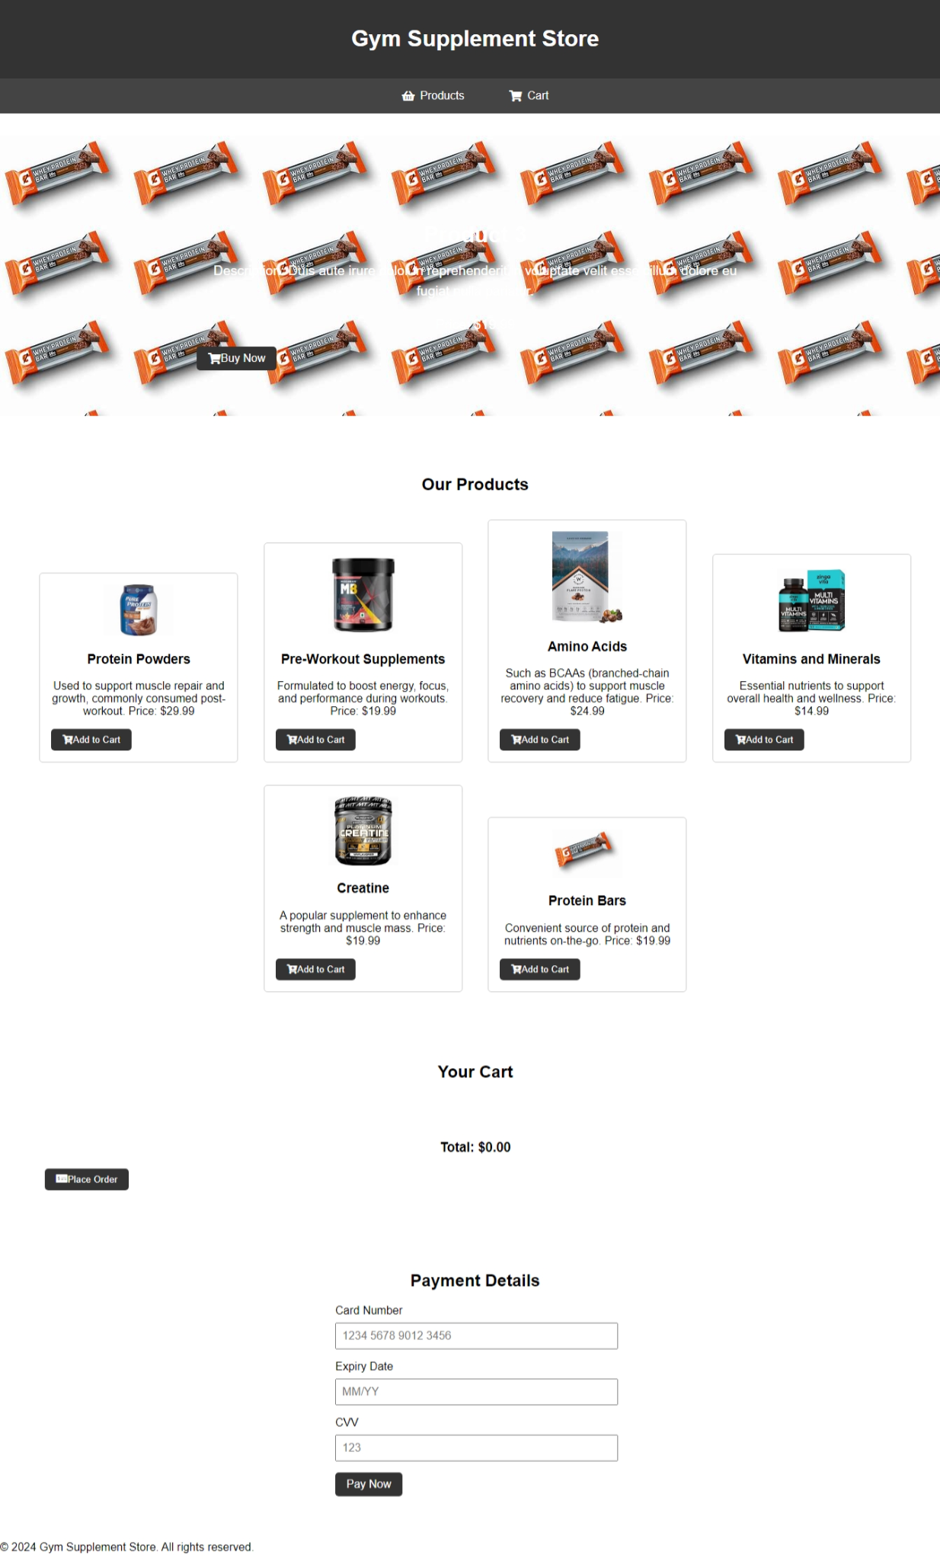
SUPPLEMENT

Slide 25

DIET

Slide 26
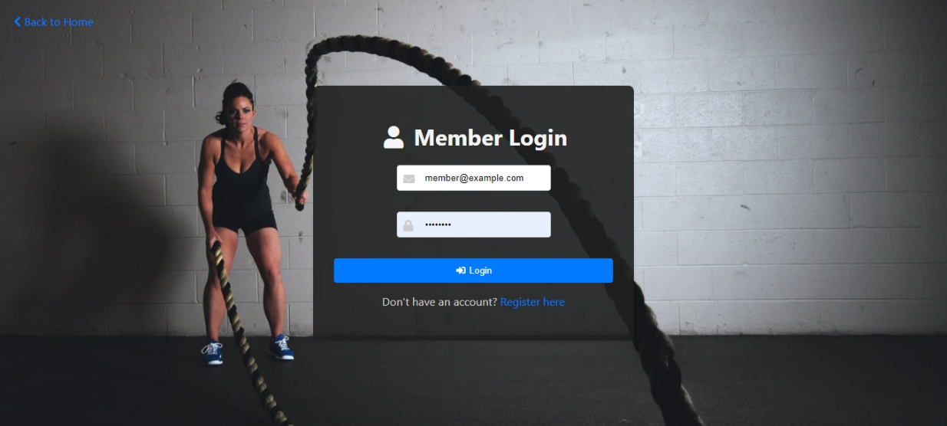
MEMBER

Slide 27

MEMBER

Slide 28
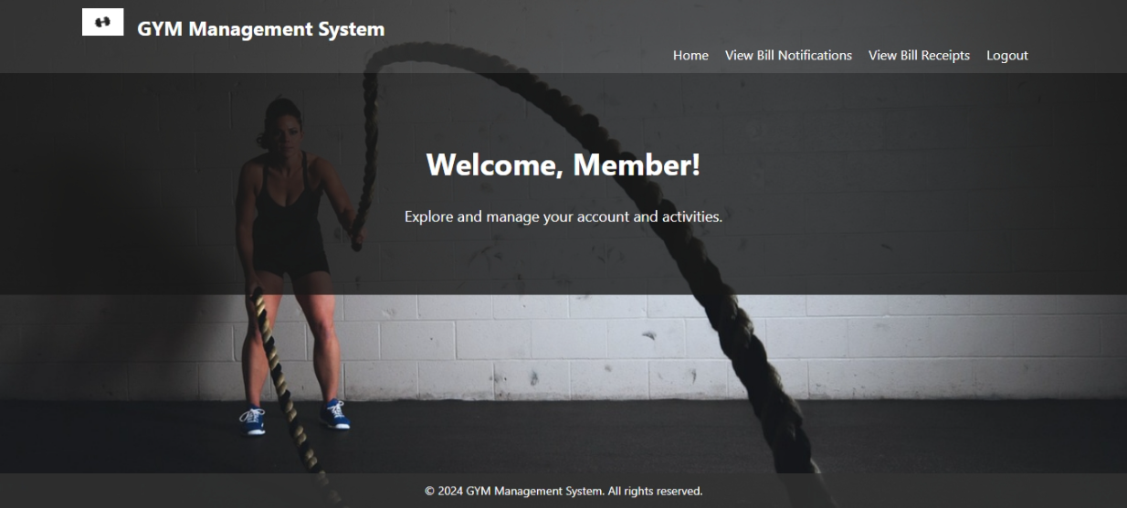
MEMBER HOME

Slide 29
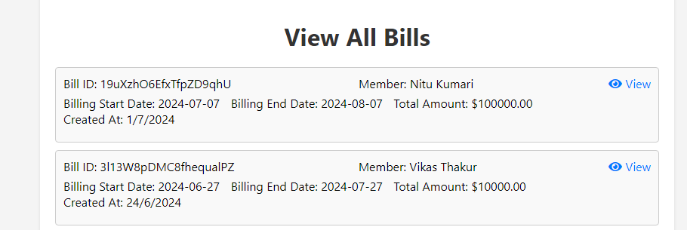
MEMBER

Slide 30
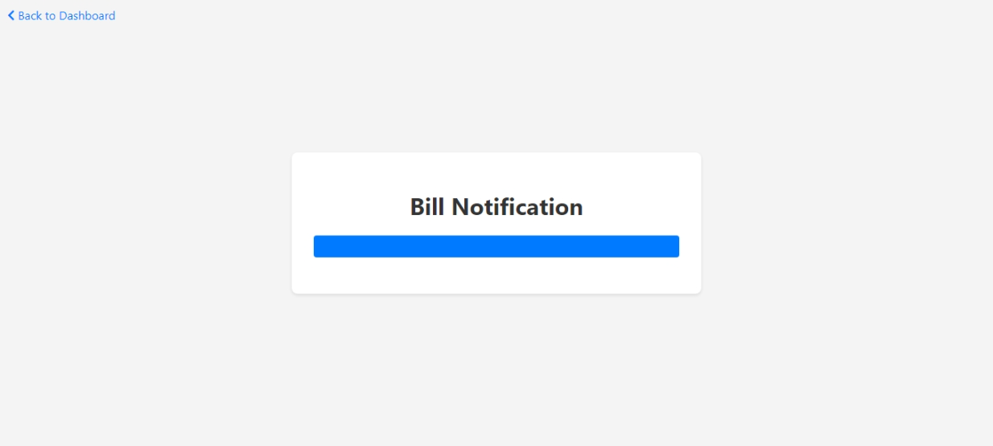
MEMBER

Slide 31
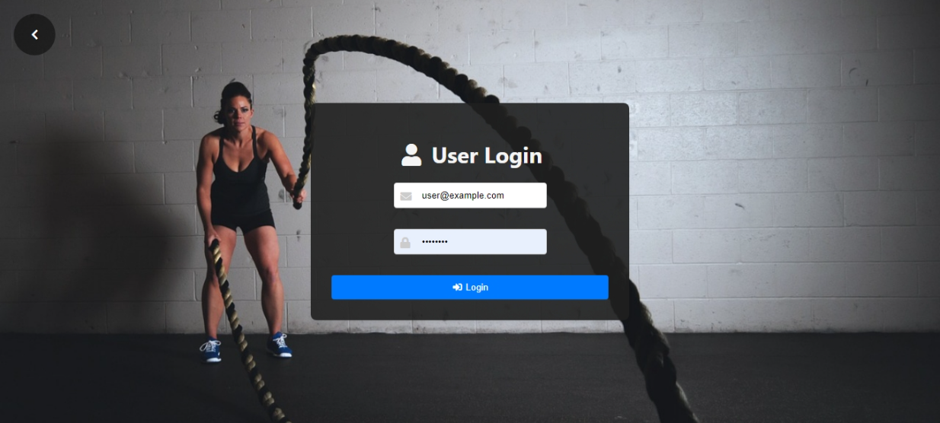
USER

Slide 32

USER HOME

Slide 33
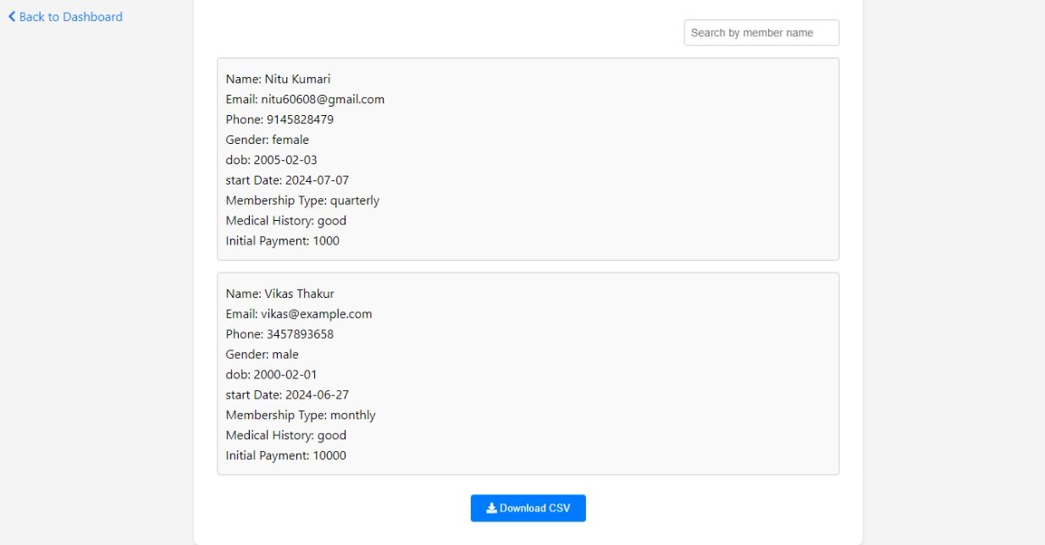
USER

Slide 34
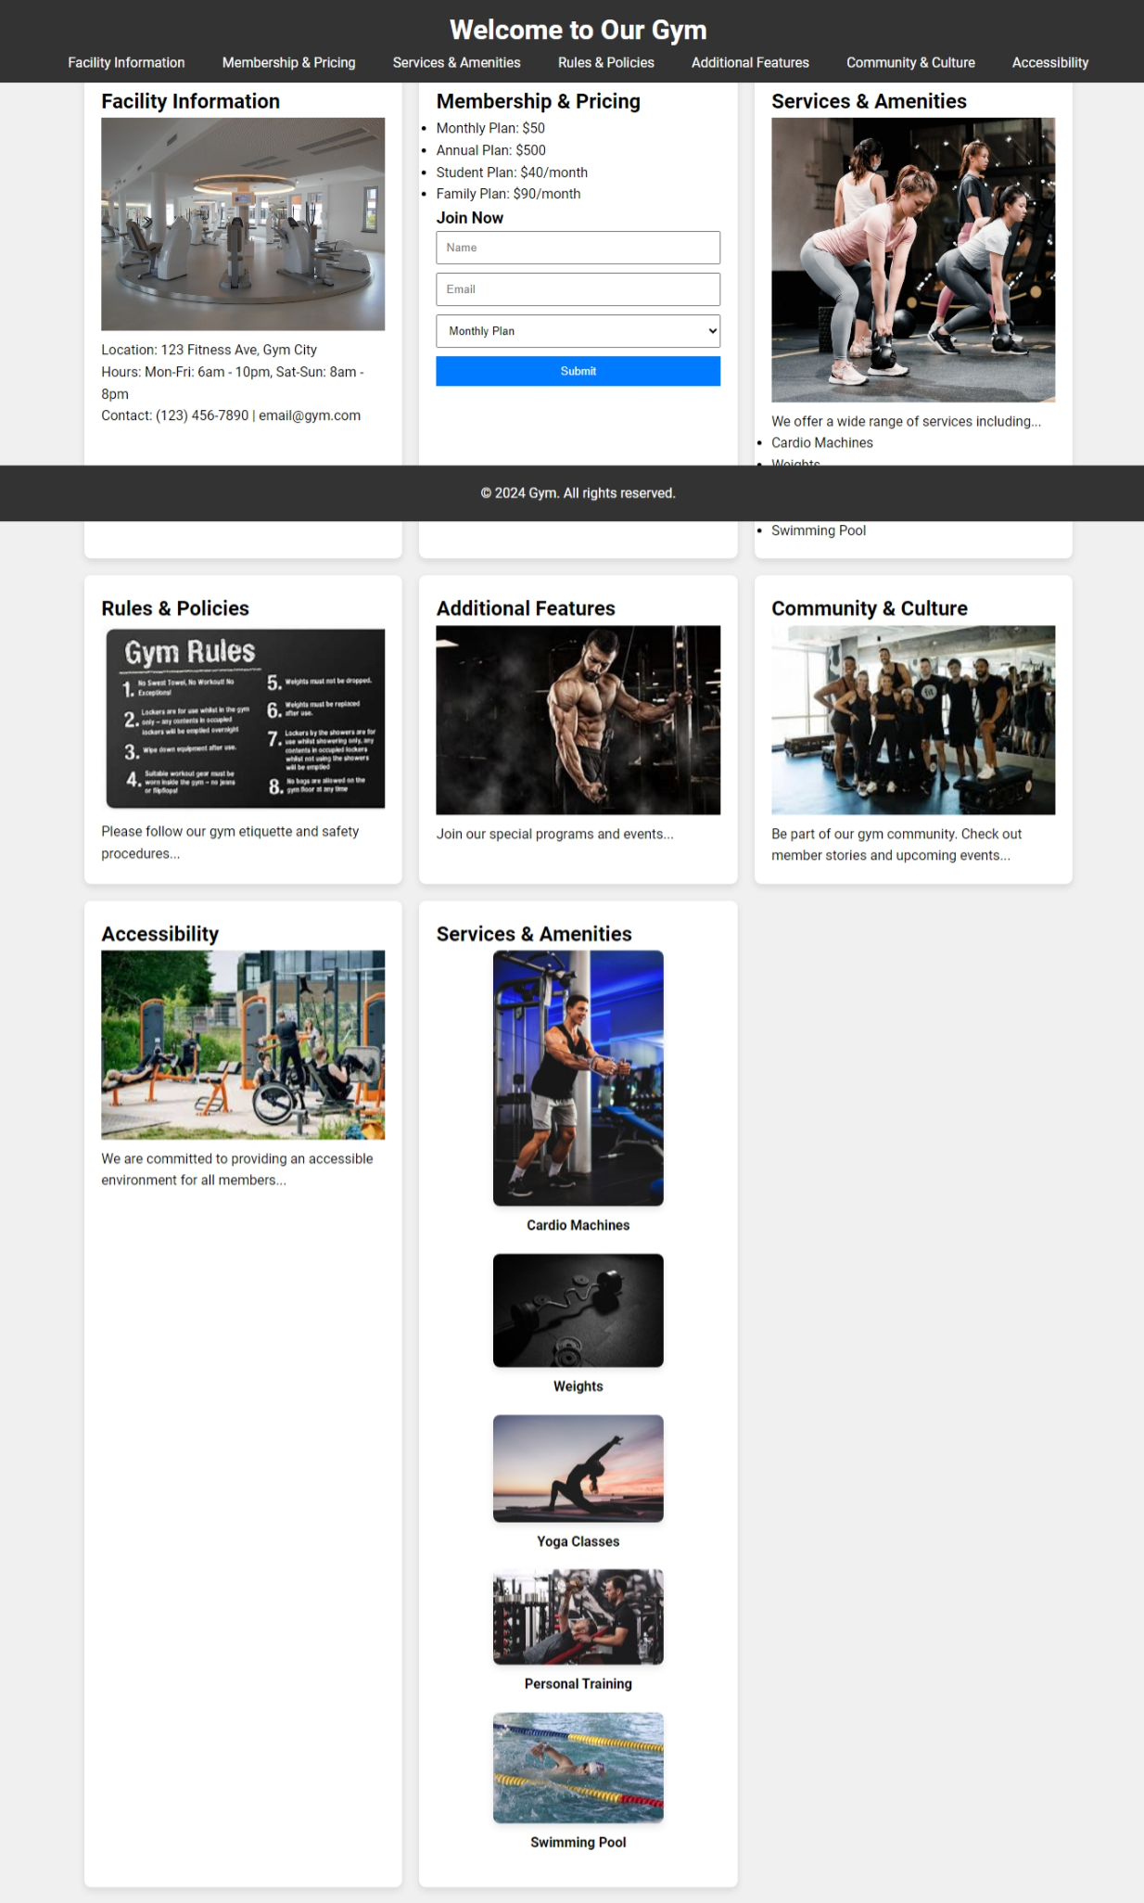
USER

Slide 35
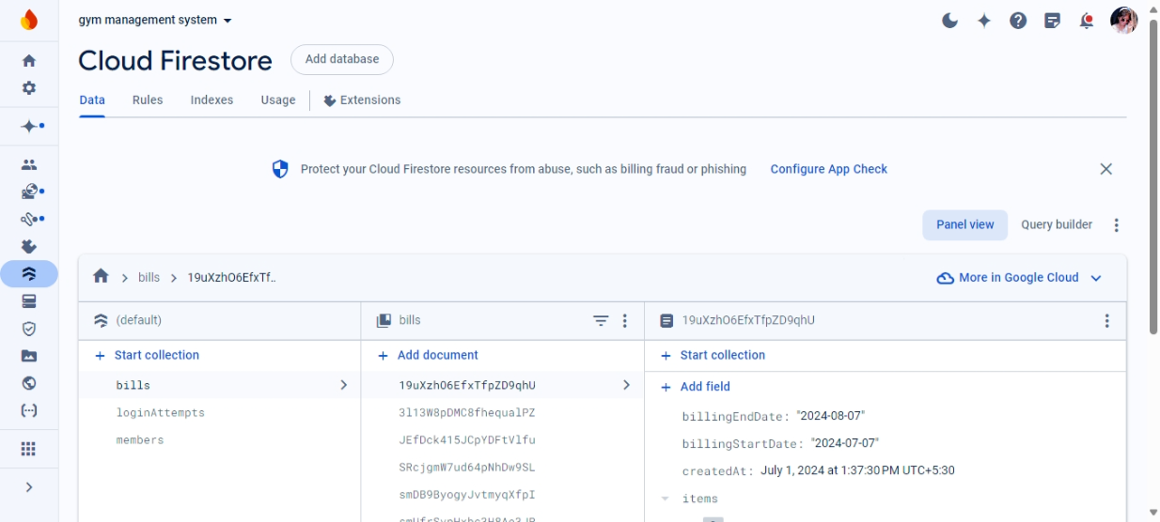
SCREENSHOT

Slide 36
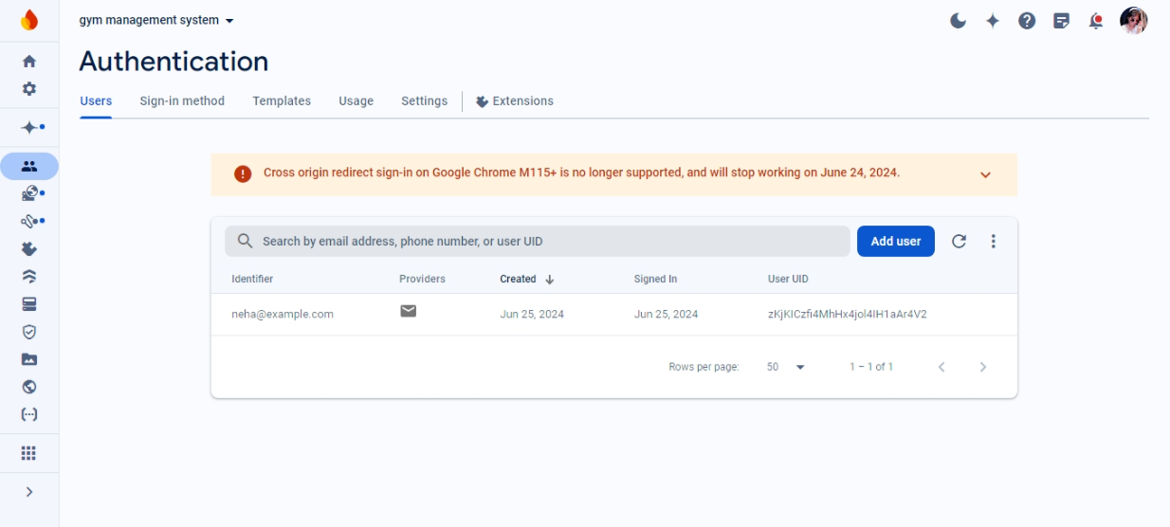
SCREENSHOT

Slide 37
CONCLUSION
The “GYM MANAGEMENT SYSTEM” is successfully designed and developed to fulfilling the necessary requirements, as identified in the requirements analysis phase, such as the system is very much user friendly, form level validation and field level validation are performing very efficiently.
The new computerized system was found to be much faster and reliable and user friendly then the existing system, the system has been designed and developed step by step and tested successfully.
It eliminates the human error that are likely to creep in the kind of working in which a bulk quantity of data and calculations as to be processed.
The system results in quick retrieval of information that is very vital for the progress any organization. Cost is minimized in case of stationary.
Burden of manual work is reduced as whenever transaction takes place, there is a no need to record it in many places manually.

